Slide 1

DyPyBench A Benchmark of Executable Python Software
Master Thesis Project of Piyush Bajaj
Examiner: Prof. Dr. Michael Pradel
Supervisor: Islem Bouzenia

Slide 2
Introduction : Background and Motivation
What is Benchmarking?
SPEC benchmarks. (https://www.spec.org/benchmarks.html)
DaCapo Benchmark. (https://www.dacapobench.org/)
Why a Dynamic Benchmark?
We choose Python since it does not have a dynamic benchmark.

Slide 3
Introduction : Challenges
Challenges faced in dynamic benchmarking
Time for setting up projects.
Different versions, dependencies and steps involved.
Time for running test cases.

Slide 4
Introduction : Proposal
With this project, we aim to solve the challenges faced in execution of Python projects and focus on performing dynamic benchmarking.
The Dynamic benchmark should consists of the following characteristics:
Large Scale
Diverse
One Click Run
Longevity
Code Analysis with DynaPyt Framework

Slide 5
Introduction : Tasks Involved
Gathering a set of 50 to 100 popular and diverse python projects and execute their code and test suites.
Design and implement a benchmark with a unique interface to setup, run and analyze different python projects.
Perform empirical study of dynamic features, call targets, objects and other features of Python using the benchmark and DynaPyt framework.

Slide 6
Approach
Selection of projects
Execution of projects
Automation
Creation of Framework
Empirical Study

Slide 7
Approach : Selection of Projects
Popular and open source projects.
Focus mainly on projects having test suites.
Automatically create test suites for other projects.
Awesome python website projects.
Projects from different categories defined by awesome python.

Slide 8
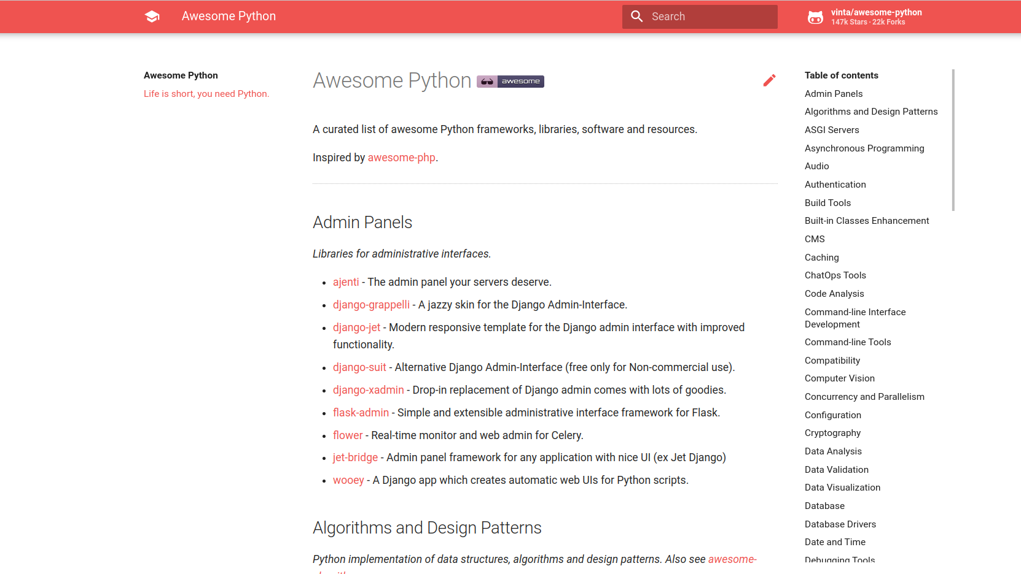
Awesome Python : Website

Slide 9
Approach : Selection of Projects (2)
Overall Projects : 679
Type of Projects : Frameworks, Libraries, Software
Main Categories : 92
Some of the main categories and the number of projects in them:
Category | No. Of Projects
Admin Panels | 9
Code Analysis | 18 (5 sub-categories)
Computer Vision | 7
Deep Learning | 7
Documentation | 3
Category | No. Of Projects
Files | 7
GUI Development | 16
Robotics | 2
Task Queues | 5
Web Frameworks | 5 (2 sub-categories)

Slide 10
Approach : Execution of Projects
Finding similarities and differences during setup and running of the selected python projects.
Generic steps for setup and running of sample projects:
Clone repository.
Create and activate python virtual environment.
Install requirements using pip or install the project using setup.py.
Install pytest for testing.
Run tests and observe result statistics such as number of test cases, success rate, time to run tests.

Slide 11
Approach: Execution of Projects (example)
Python Robotics
Flask-Api
git clone https://github.com/AtsushiSakai/PythonRobotics.git
virtualenv vm
source vm/bin/activate
pip install -r requirements/requirements.txt
pytest tests/
103 tests in 314.54 seconds, failures = 0
git clone https://github.com/flask-api/flask-api.git
virtualenv vm
source vm/bin/activate
python setup.py install
pip install pytest
pytest flask_api/tests
63 tests in 0.55 seconds, failures = 1

Slide 12
Approach : Automation
Automate all the steps involved in setting up the selected python projects.
Automate the steps involved for executing the test suites of selected python projects.
Execute common steps automatically for executing tests of any new python project.

Slide 13
Result of Project : Creation of Framework
Create a framework for dynamic benchmarking.
Framework should be able to run test cases for different python projects.
Framework should be able to perform dynamic analysis of python projects.

Slide 14
Evaluation : Empirical Study
Study dynamic properties of python using benchmark and DynaPyt framework.
Some dynamic properties to be studied include:
Objects
Call Targets
Variable usage

Slide 15
Current Status
Selection of projects
Execution of projects
Automation
Creation of Framework
Empirical Study

Slide 16
Questions and Suggestions ?

Slide 17
Thank You

